Slide 1



Day 14 — Hybrid Search
Author: devopspro srt
Created with Pi

Slide 2
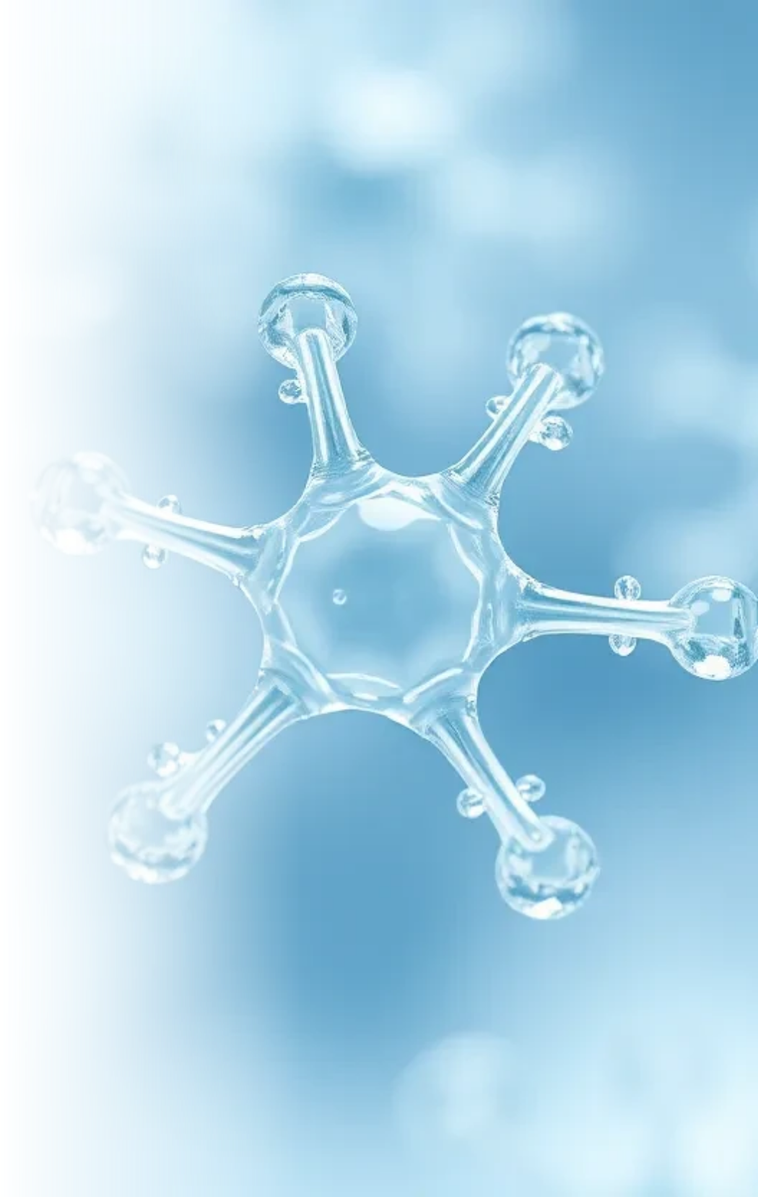

1. Keyword + Vector • CloudByteHub.ai
Why Hybrid?
1
Keywords: exact matches.
2
Vectors: semantic matches.
3
Combine for better recall & precision.

Slide 3
Thank You

